Slide 1


Installation Packages
Week 1 - Practical
Desmond Moru, PhD
Desmond Moru, PhD
Desmond Moru, PhD
Chukwudi Ofoma
Chukwudi Ofoma
Chukwudi Ofoma
2026/2027 Session
SST/Computer Science
SST/Computer Science
SST/Computer Science
Pan-Atlantic University

Slide 2
Today's Practical
Part 1
Meet the tools
GitHub, Git Bash, Sublime Text, Rust and PostgreSQL, and what each one is for.
Part 2
Set up GitHub
Create your account, create a repository and install Git Bash.
Part 3
Your first commit
Clone the repository, write a program, then add, commit and push it.

Slide 3


PART 1 OF 3
The Tools
What each software package does and why this course needs it.

Slide 4





The Software Packages
GitHub
Hosts your code online
Git Bash
Runs Git commands
Sublime Text
Where you write code
Rust
Our programming language
PostgreSQL
Stores data, used later on
Today we set up the first three. Rust and PostgreSQL join us in the coming weeks.

Slide 5
What is GitHub?
A home for your code
A website and cloud service where developers store and manage code, and track every change made to it.
Version control
Keeps the full history of a project, so a growing team can see, compare and undo changes safely.
Git underneath
Git is the distributed version-control system doing the work. Every developer has the full codebase and history, which makes branching and merging easy.

Slide 6
What is Sublime Text?
A source-code editor
A fast, cross-platform editor that natively supports many programming and markup languages.
Built for writing code
Syntax highlighting, quick file finding and a clean interface make it friendly for new programmers.
Where you will work
Every program you write in this course starts in Sublime Text.

Slide 7
What is Rust?
A systems programming language
Focused on three goals: safety, speed and concurrency.
Familiar syntax
Its syntax is similar to C++. Open source, originally developed at Mozilla Research.
Low-level control
You decide how memory is used: the stack for static allocation, the heap for dynamic allocation.

Slide 8
What is PostgreSQL?
An object-relational database
A powerful open-source database system with a strong reputation for reliability and performance.
Standards and extensibility
Also known as Postgres. Emphasizes SQL compliance and lets you extend it with your own types.
The data store behind apps
The primary database for many web, mobile, geospatial and analytics applications.

Slide 9
PART 2 OF 3
Set Up GitHub
Create your account and repository, then install Git Bash.

Slide 10
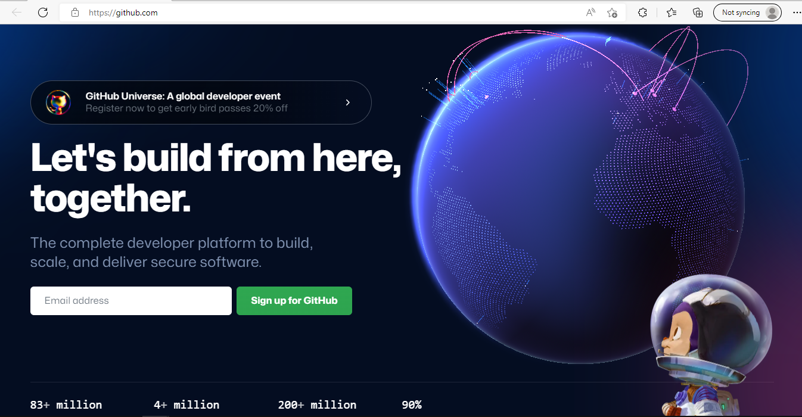
Set up a GitHub account
1
Go to
github.com/join
2
Type a username, your email address and a password
3
Choose “Sign up for GitHub” and follow the instructions

Slide 11
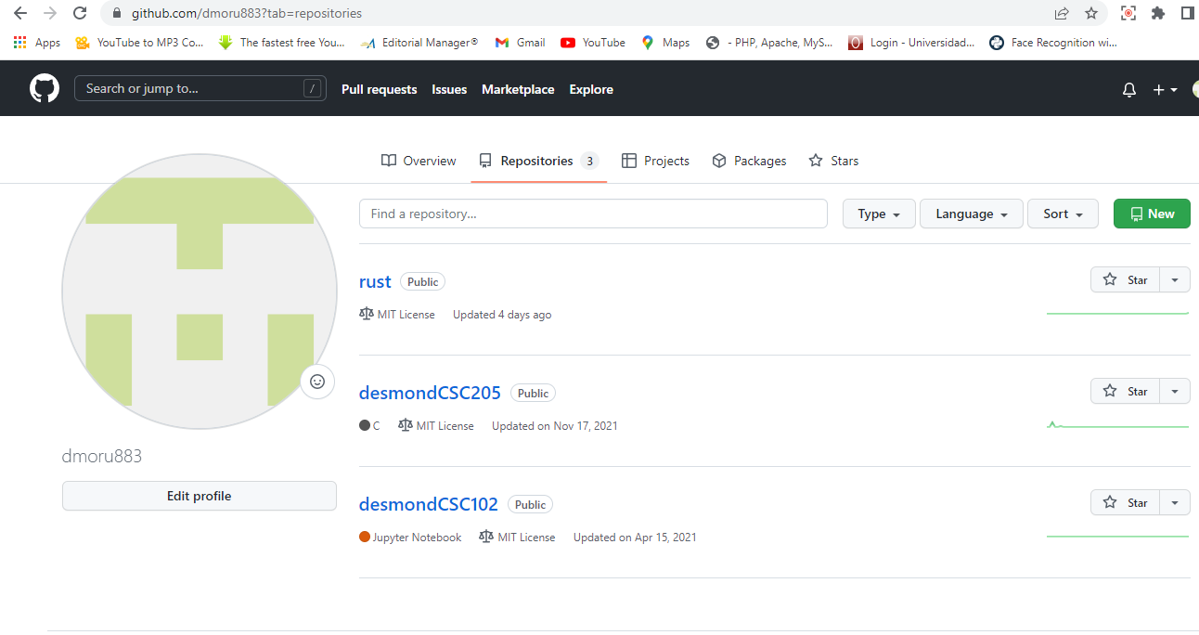
Create a repository
1
Open your profile and go to Repositories
2
Click the green “New” button

Slide 12
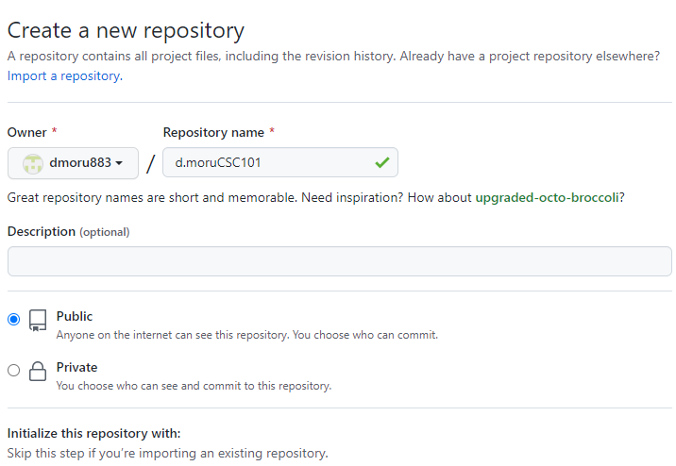
Name your repository
1
Enter a repository name
Use yourname-COS101, e.g. d.moruCOS101
2
Check “Public”

Slide 13
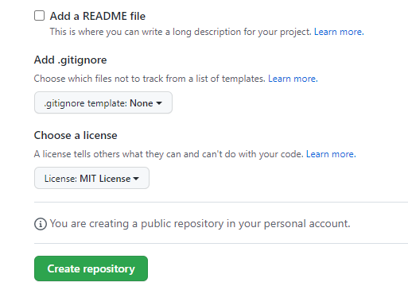
Add a licence and create
1
Choose the MIT Licence
2
Click “Create repository”

Slide 14
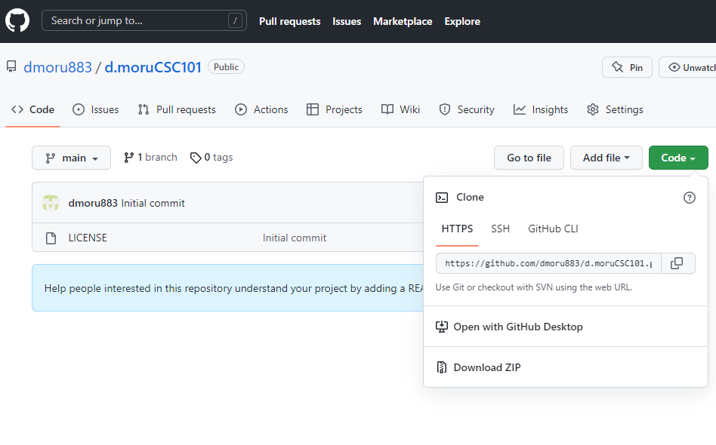
Copy the repository URL
1
Click the green “Code” button
2
Copy the HTTPS URL
You will need it to clone in Part 3.

Slide 15
Install Git Bash
1
Go to
git-scm.com/downloads
2
Download Git for Windows, Mac or Linux
3
Install it by following the instructions
Accept the default options.

Slide 16
PART 3 OF 3
Your First Commit
From cloning the repository to pushing your first program.

Slide 17
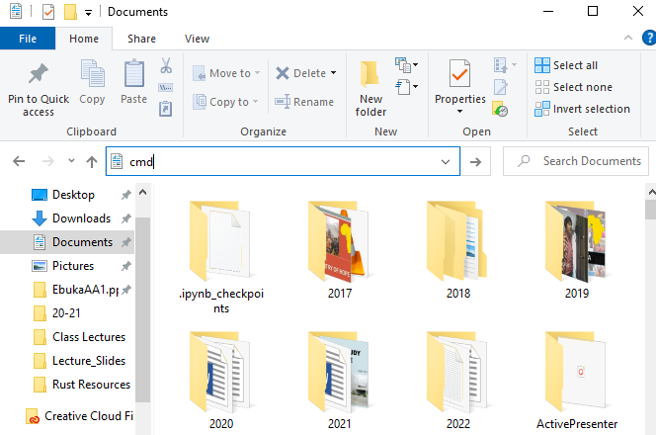
Open a terminal in Documents
1
Open your Documents folder
2
Type in the address bar
cmd
3
Press Enter
A command prompt opens inside Documents.

Slide 18
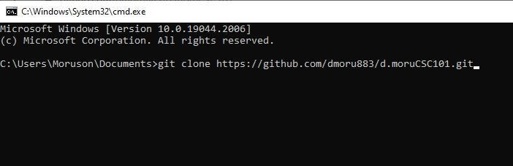
Clone your repository
1
Type
git clone <your-github-url>
2
Press Enter
Paste the URL you copied from GitHub.

Slide 19
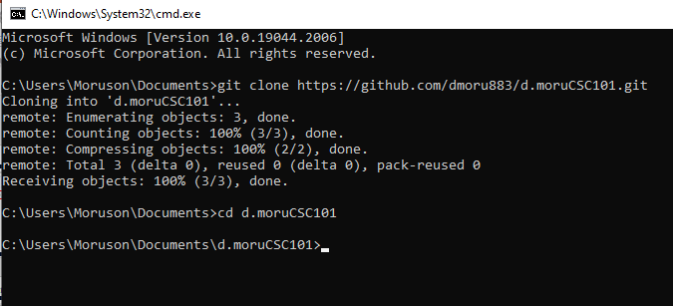
Enter the repository
1
Type
cd <your-repository-name>
2
Press Enter

Slide 20
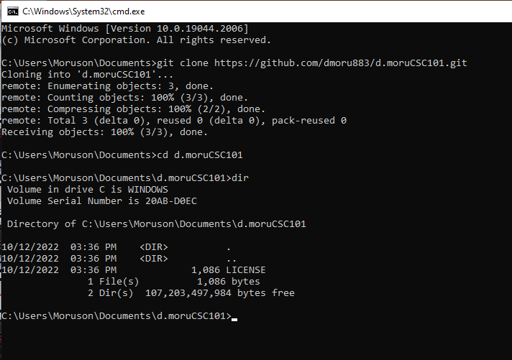
Check what is inside
1
Type
dir
2
Press Enter
dir lists every file and folder in the current directory.

Slide 21
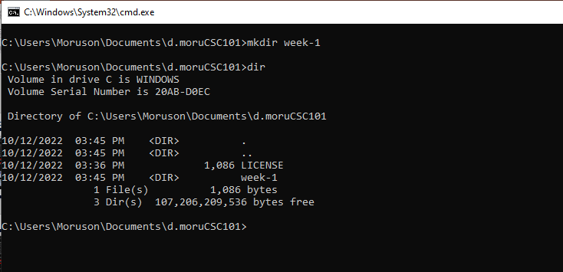
Create a week-1 folder
1
Type
mkdir week-1
2
Press Enter

Slide 22
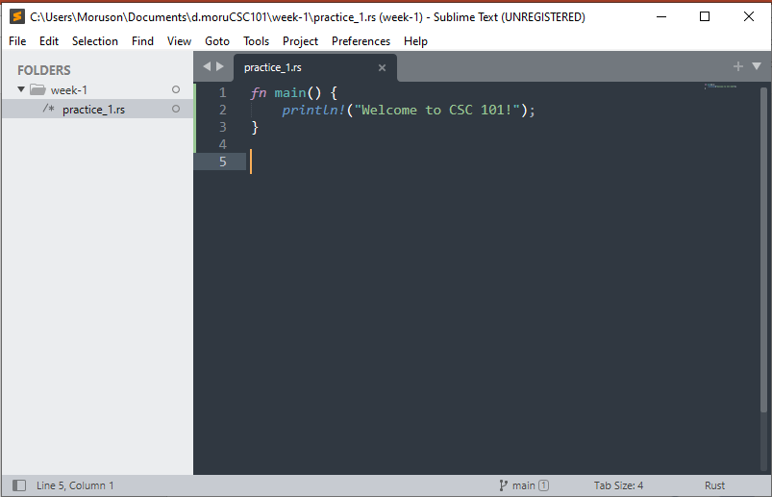
Write your first program
1
Open Sublime Text and type the code
2
Save it as
practice_1.rs
3
Save inside the week-1 folder of your cloned repository

Slide 23
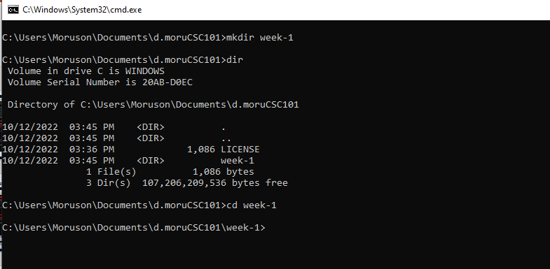
Move into week-1
1
Type
cd week-1
2
Press Enter
Tip: cls clears the screen whenever the terminal gets crowded.

Slide 24
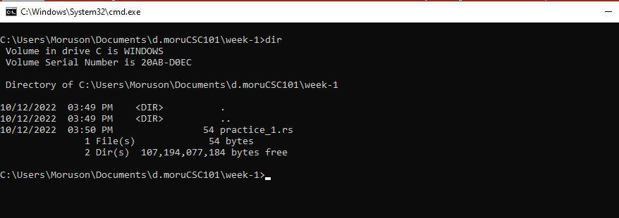
Confirm your file is there
1
Type
dir
2
Press Enter
You should see practice_1.rs listed.

Slide 25
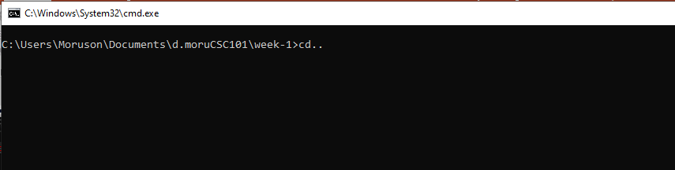
Back to the repository root
1
Type
cd ..
2
Press Enter
Git commands run from the repository root.

Slide 26
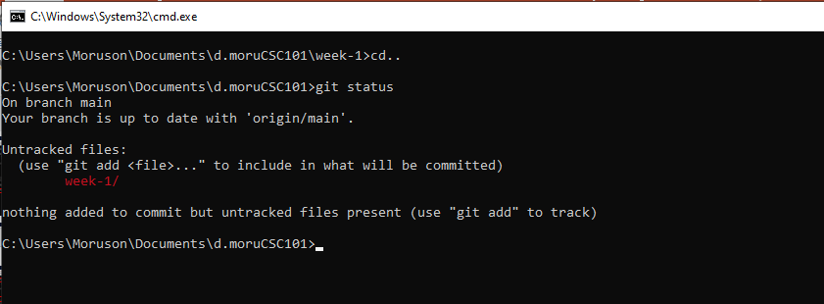
Check the status
1
Type
git status
2
Press Enter
Git shows week-1 as untracked since it is new.

Slide 27
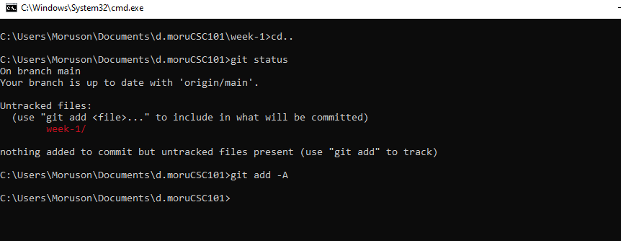
Stage your files
1
Type
git add –A
Or
git add .
2
Press Enter
"-A" or "." stages every new and changed file.

Slide 28
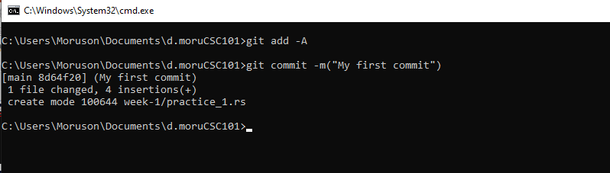
Commit your work
1
Type
git commit -m "My first commit"
2
Press Enter
The message describes what this snapshot contains.

Slide 29
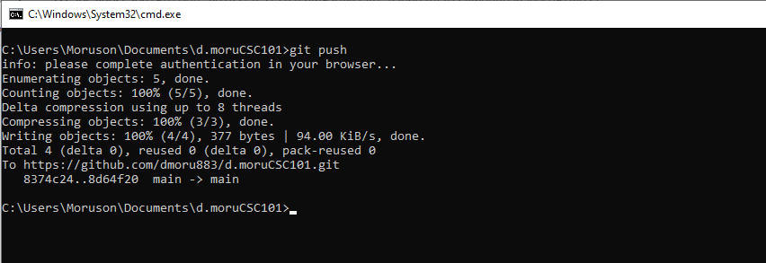
Push to GitHub
1
Type
git push
2
Press Enter
Sign in through the browser if Git asks you to.

Slide 30
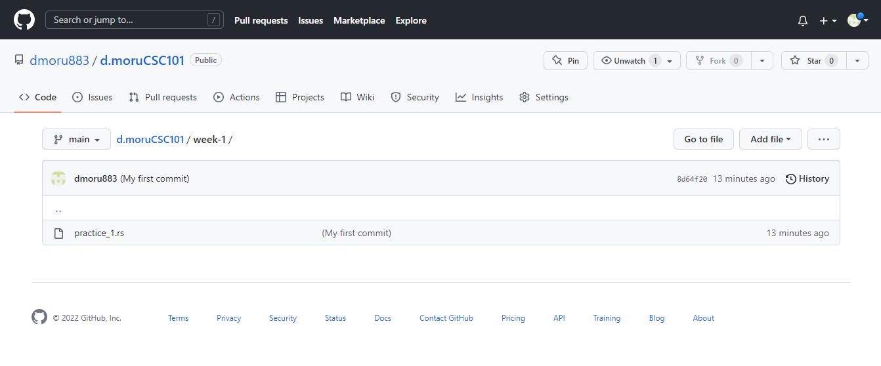
Check it on GitHub
1
Refresh your repository page in the browser
2
You should see week-1 with practice_1.rs inside

Slide 31
The Whole Workflow
01 · Get the code
git clone <url>
cd <repository>
02 · Make changes
mkdir week-1
write code in Sublime
save as practice_1.rs
03 · Record them
git status
git add -A
git commit -m "..."
04 · Publish
git push
refresh GitHub
Same four moves every week. By Week 3 this is muscle memory.

Slide 32


Questions?
Homework: push practice_1.rs before the next class.
www.pau.edu.ng
pau_Nigeria
Pan-Atlantic University

